Slide 1

Team Alpaca
The Team: Taylor, Even, Adam

Slide 2
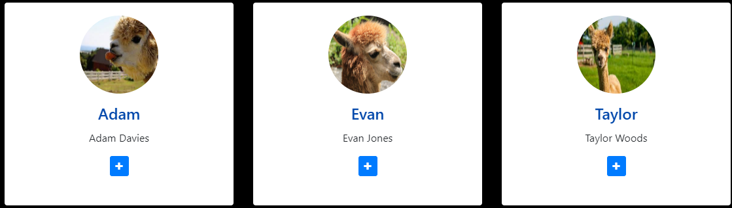
The Team

Slide 3

COBOL
common business-oriented language

Slide 4
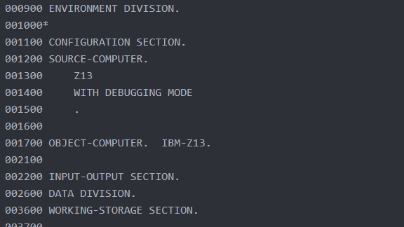
COBOL CODE: How it works
DIVISIONS
SECTIONS
VARIABLES USED

Slide 5
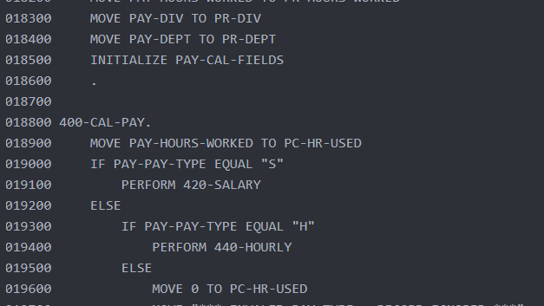
COBOL CODE: How it works
COBOL RULES
RULER
80 CHAR

Slide 6

Why use COBOL?
Documents, reliability, & security

Slide 7
Our Website
https://team-alpaca.herokuapp.com/Content/home.php

